Slide 1

Algorithms & Data Structure
Sorting Algorithms
Dr. Ibraheem Al-Dhamari
ia@idhamari.com
5.5.2026
Dr. Ibraheem Al-Dhamari ia@idhamari.com

Slide 2

Note:
This presentation and all resources are available publicly in my Github repository for free, please use the link below or scan the QR code
https://github.com/ia-dev/algorithms
If you have questions in the future, feel free to use the discussion tab in the Github repository:
https://github.com/ia-dev/algorithms/discussions
Dr. Ibraheem Al-Dhamari ia@idhamari.com

Slide 3
Content
1. Terminology:
- Algorithms
- Sorting
2. Sorting algorithms:
- Bubble sort
- Selection sort
- Radix Sort
3. Resources
- Readings:
- Websites
- Video lecures
Dr. Ibraheem Al-Dhamari ia@idhamari.com

Slide 4
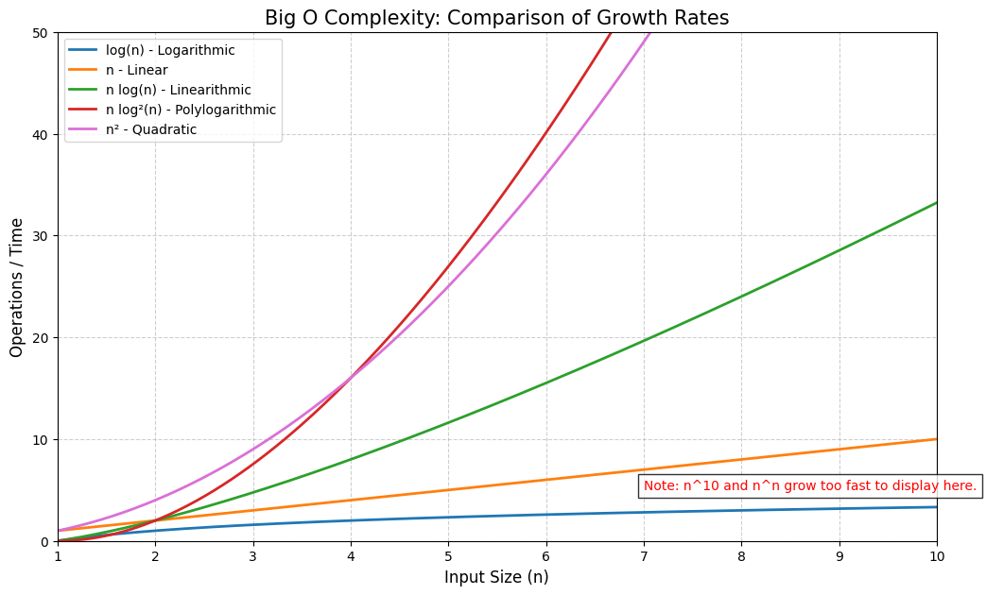
1. Terminology, Algorithms:
What is algorithm?
A finite, deterministic, and effective problem-solving method suitable for implementation as a computer program.
Muhammad ibn Musa al-Khwarizmi provided the first systematic, step-by-step instructions for simple math operations.
Pseudocode: describing the algorithms steps in a way between natural language and a computer program.
Why it is important?
Practilicaty e.g. Time and Memory.
How to compare algorithms?
Using Big O notation (the worst case)
O(log(n)) algorithm is better than O(n) algorithm
Big O strip away constants and coefficients
Focus on the "shape" of the scaling.
Dr. Ibraheem Al-Dhamari ia@idhamari.com

Slide 5
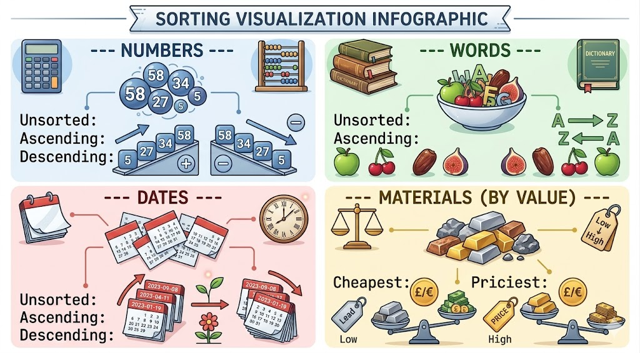
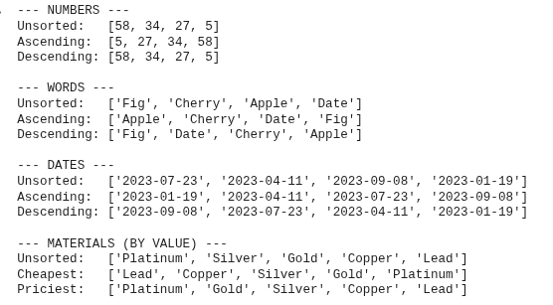
1. Terminology, Sorting:
What is sorting?
Arranging a collection of data into a specific, meaningful logical order.
Why it is important?
Making the data easier to search, analyze, or visualize.
Some popular sorting algorithms:
Bubble sort
Selection sort
Insertion sort
Radix sort
Merge sort
Quick sort
Powersort
Dr. Ibraheem Al-Dhamari ia@idhamari.com

Slide 6
2. Sorting, Bubble Sort:
A simple sorting algorithm that repeatedly compares adjacent elements, and swaps them if they are out of order.
The largest element 'bubble' to the top of the list.
64
25
12
22
11
25
64
12
22
11
25
12
64
22
11
25
12
22
64
11
25
12
22
11
64
Dr. Ibraheem Al-Dhamari ia@idhamari.com

Slide 7
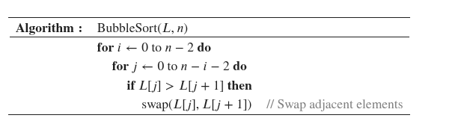
Bubble Sort:
n = 5
i = 0 to 3
j = 0 to 5-i-2
i = 0 -> 0 to 3 four times
i = 1 -> 0 to 2 three times
i = 2 -> 0 to 1 two times
i = 3 -> 0 to 0 one time
Total = 4+3+2+1 = 10 times
64
25
12
22
11
i = 0, j = 0
64
25
12
22
11
25
64
12
22
11
i = 0, j = 1
step | i | j | L [ j ] | L [ j+1 ]
1 | 0 | 0 | 64 | 25
2 | 0 | 1 | 64 | 12
3 | 0 | 2 | 64 | 22
4 | 0 | 3 | 64 | 11
25
64
12
22
11
25
12
64
22
11
i = 0, j = 2
25
12
64
22
11
25
12
22
64
11
i = 0, j = 3
25
12
22
64
11
25
12
22
11
64
Dr. Ibraheem Al-Dhamari ia@idhamari.com

Slide 8
Bubble Sort:
n = 5
i = 0 to 3
j = 0 to 5-i-2
i = 0 -> 0 to 3 four times
i = 1 -> 0 to 2 three times
i = 2 -> 0 to 1 two times
i = 3 -> 0 to 0 one time
Total = 4+3+2+1 = 10 times
25
12
22
11
64
i = 1, j = 0
25
12
22
11
64
12
25
22
11
64
i = 1, j = 1
Idx | i | j | L [ j ] | L [ j+1 ]
1 | 0 | 0 | 64 | 25
2 | 0 | 1 | 64 | 12
3 | 0 | 2 | 64 | 22
4 | 0 | 3 | 64 | 11
5 | 1 | 0 | 25 | 12
6 | 1 | 1 | 25 | 22
7 | 1 | 2 | 25 | 11
12
25
22
11
64
12
22
25
11
64
i = 2, j = 2
12
22
25
11
64
12
22
11
25
64
12
22
11
25
64
Dr. Ibraheem Al-Dhamari ia@idhamari.com

Slide 9
Bubble Sort:
n = 5
i = 0 to 3
j = 0 to 5-i-2
i = 0 -> 0 to 3 four times
i = 1 -> 0 to 2 three times
i = 2 -> 0 to 1 two times
i = 3 -> 0 to 0 one time
Total = 4+3+2+1 = 10 times
12
22
11
25
64
i = 2, j = 0
12
22
11
25
64
12
22
11
25
64
i = 2, j = 1
Idx | i | j | L [ j ] | L [ j+1 ]
1 | 0 | 0 | 64 | 25
2 | 0 | 1 | 64 | 12
3 | 0 | 2 | 64 | 22
4 | 0 | 3 | 64 | 11
5 | 1 | 0 | 25 | 12
6 | 1 | 1 | 25 | 22
7 | 1 | 2 | 25 | 11
8 | 2 | 0 | 12 | 22
9 | 2 | 1 | 22 | 11
12
22
11
25
64
12
11
22
25
64
12
11
22
25
64
Dr. Ibraheem Al-Dhamari ia@idhamari.com

Slide 10
Bubble Sort:
n = 5
i = 0 to 3
j = 0 to 5-i-2
i = 0 -> 0 to 3 four times
i = 1 -> 0 to 2 three times
i = 2 -> 0 to 1 two times
i = 3 -> 0 to 0 one time
Total = 4+3+2+1 = 10 times
12
11
22
25
64
i = 3, j = 0
12
11
22
25
64
11
12
22
25
64
Idx | i | j | L [ j ] | L [ j+1 ]
1 | 0 | 0 | 64 | 25
2 | 0 | 1 | 64 | 12
3 | 0 | 2 | 64 | 22
4 | 0 | 3 | 64 | 11
5 | 1 | 0 | 25 | 12
6 | 1 | 1 | 25 | 22
7 | 1 | 2 | 25 | 11
8 | 2 | 0 | 12 | 22
9 | 2 | 1 | 22 | 11
10 | 3 | 0 | 12 | 11
11
12
22
25
64
11
12
22
25
64
64
25
12
22
11
11
12
22
25
64
Dr. Ibraheem Al-Dhamari ia@idhamari.com

Slide 11
Bubble Sort:
Time:
𝚹(n²): Worst case.
𝚹(n²): Average case.
𝚹(n²): Best case.
Space:
O(1): In-place sorting.
The number of comparisons is fixed >= the number of exchange.
The data's initial order does not affect the algorithm performance.
Dr. Ibraheem Al-Dhamari ia@idhamari.com

Slide 12
2. Sorting, Selection Sort:
One of the simplest sorting algorithms that works by repeatedly selecting the smallest remaining item.
The smallest element is selected and placed in the beginning.
64
25
12
22
11
11
25
12
22
64
11
12
25
22
64
11
12
22
25
64
11
12
22
25
64
Dr. Ibraheem Al-Dhamari ia@idhamari.com

Slide 13
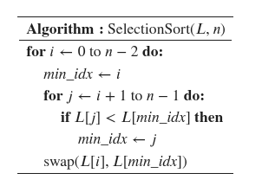
Selection Sort:
n = 5
i = 0 to 3
j = i+1 to 4
i = 0 -> 1 to 4 four times
i = 1 -> 2 to 4 three times
i = 2 -> 3 to 4 two times
i = 3 -> 4 to 4 one time
Total = 4+3+2+1 = 10 times
64
25
12
22
11
64
25
12
22
11
i = 0, j = 1, min_idx = 0 ->1
64
25
12
22
11
i = 0, j = 2, min_idx = 1 ->2
step | i | j | m | L [ j ] | L [m ]
1 | 0 | 1 | 0 | 25 | 64
2 | 0 | 2 | 1 | 12 | 25
3 | 0 | 3 | 2 | 22 | 12
4 | 0 | 4 | 2 | 11 | 12
64
25
12
22
11
i = 0, j = 3, min_idx = 2
64
25
12
22
11
i = 0, j = 4, min_idx = 2 ->4
64
25
12
22
11
11
25
12
22
64
Dr. Ibraheem Al-Dhamari ia@idhamari.com

Slide 14
Selection Sort:
n = 5
i = 0 to 3
j = i+1 to 4
i = 0 -> 1 to 4 four times
i = 1 -> 2 to 4 three times
i = 2 -> 3 to 4 two times
i = 3 -> 4 to 4 one time
Total = 4+3+2+1 = 10 times
11
25
12
22
64
11
25
12
22
64
i = 1, j = 2, min_idx = 1 ->2
11
25
12
22
64
i = 1, j = 3, min_idx = 2
step | i | j | m | L [ j ] | L [m ]
1 | 0 | 1 | 0 | 25 | 64
2 | 0 | 2 | 1 | 12 | 25
3 | 0 | 3 | 2 | 22 | 12
4 | 0 | 4 | 2 | 11 | 12
5 | 1 | 2 | 1 | 12 | 25
6 | 1 | 3 | 2 | 22 | 12
7 | 1 | 4 | 2 | 64 | 12
11
25
12
22
64
i = 1, j = 4, min_idx = 2
11
25
12
22
64
11
12
25
22
64
Dr. Ibraheem Al-Dhamari ia@idhamari.com

Slide 15
Selection Sort:
n = 5
i = 0 to 3
j = i+1 to 4
i = 0 -> 1 to 4 four times
i = 1 -> 2 to 4 three times
i = 2 -> 3 to 4 two times
i = 3 -> 4 to 4 one time
Total = 4+3+2+1 = 10 times
11
12
25
22
64
11
12
25
22
64
i = 2, j = 3, min_idx = 2 ->3
11
12
25
22
64
i = 2, j = 4, min_idx = 3
step | i | j | m | L [ j ] | L [m ]
1 | 0 | 1 | 0 | 25 | 64
2 | 0 | 2 | 1 | 12 | 25
3 | 0 | 3 | 2 | 22 | 12
4 | 0 | 4 | 2 | 11 | 12
5 | 1 | 2 | 1 | 12 | 25
6 | 1 | 3 | 2 | 22 | 12
7 | 1 | 4 | 2 | 64 | 12
8 | 2 | 3 | 2 | 22 | 25
9 | 2 | 4 | 3 | 64 | 22
10 | 3 | 4 | 3 | 64 | 25
11
12
25
22
64
11
12
22
25
64
11
12
22
25
64
i = 3, j = 4, min_idx = 3
11
12
22
25
64
11
12
22
25
64
64
25
12
22
11
11
12
22
25
64
Dr. Ibraheem Al-Dhamari ia@idhamari.com

Slide 16
Selection Sort:
Time:
𝚹(n²): Worst case.
𝚹(n²): Average case.
𝚹(n²): Best case.
Space:
O(1): In-place sorting.
The number of comparisons is fixed
The number of exchange is much smaller than the bubble sort.
O(n) vs O(n²)
The data's initial order does not affect the algorithm performance.
Dr. Ibraheem Al-Dhamari ia@idhamari.com

Slide 17
2. Sorting, Radix Sort:
Non-comparative integer sorting algorithm that sorts data with integer keys by grouping the keys by individual digits that share the same significant position and value.
Highly efficient but requires known small maximum number of digits.
64
25
12
22
11
ss
Buckets
0
1
2
3
4
5
6
7
8
9
11
12
64
25
Digit 0
11
12
22
64
25
22
11
22
64
Digit 1
11
12
22
25
64
12
25
Dr. Ibraheem Al-Dhamari ia@idhamari.com

Slide 18
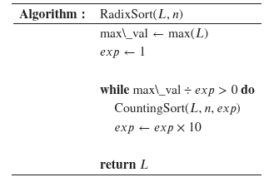
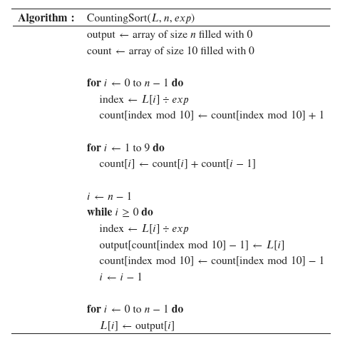

Radix Sort:
Dr. Ibraheem Al-Dhamari ia@idhamari.com

Slide 19
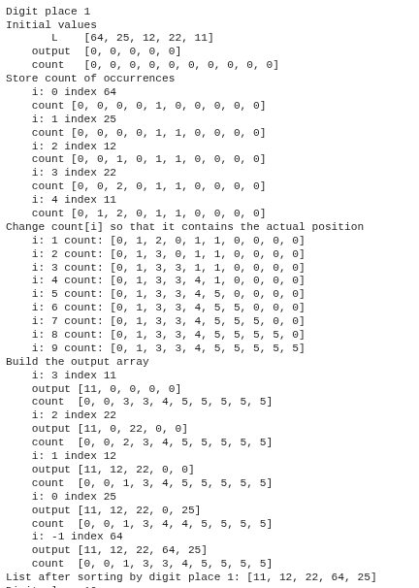
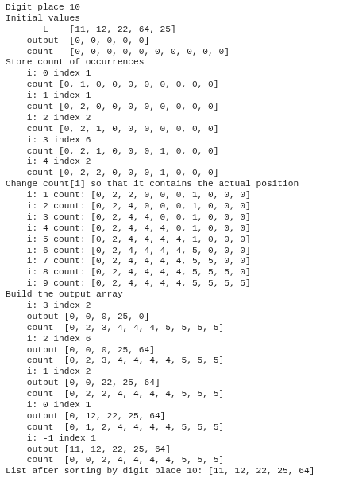
Radix Sort:
Dr. Ibraheem Al-Dhamari ia@idhamari.com

Slide 20
Radix Sort:
Time:
𝚹(d(n+k)): Worst case.
𝚹(d(n+k)): Average case.
𝚹(d(n+k)): Best case.
Space:
O(n+k): Not in-place sorting.
The data's initial order does not affect the algorithm performance.
Dr. Ibraheem Al-Dhamari ia@idhamari.com

Slide 21
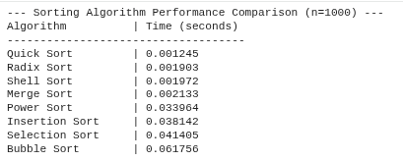
2. Sorting, SOTA:
There are more efficient sorting algorithms with O(n log(n)) e.g.
Merge Sort.
Quick Sort.
Power Sort.
Please see the shared Colab Notebook for more information!
Dr. Ibraheem Al-Dhamari ia@idhamari.com

Slide 22
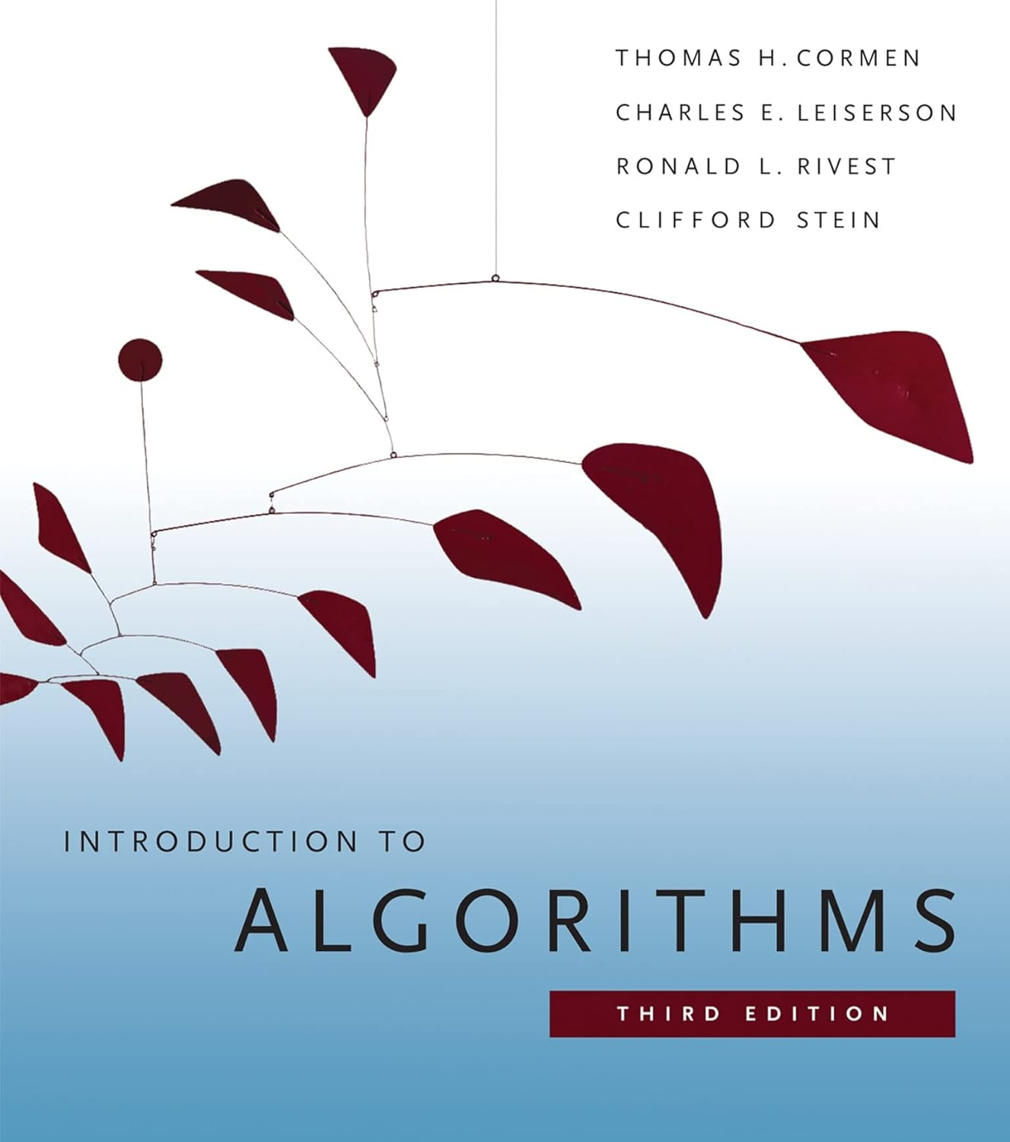
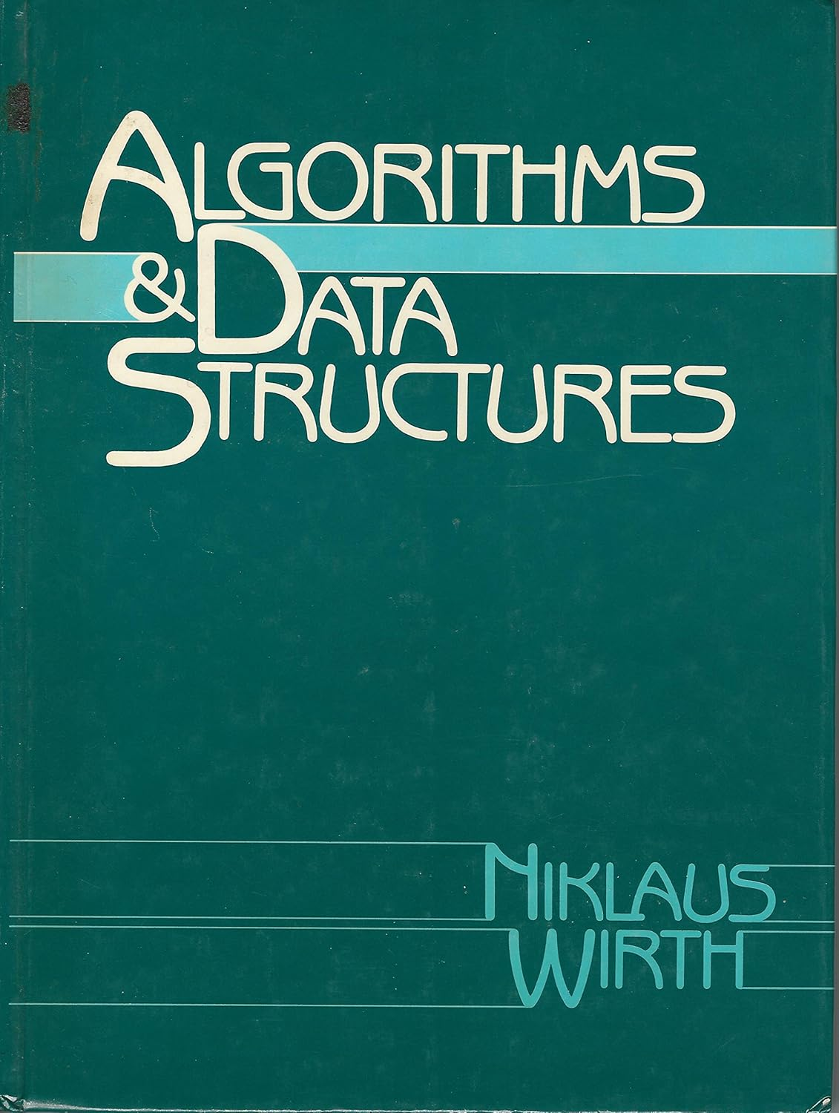
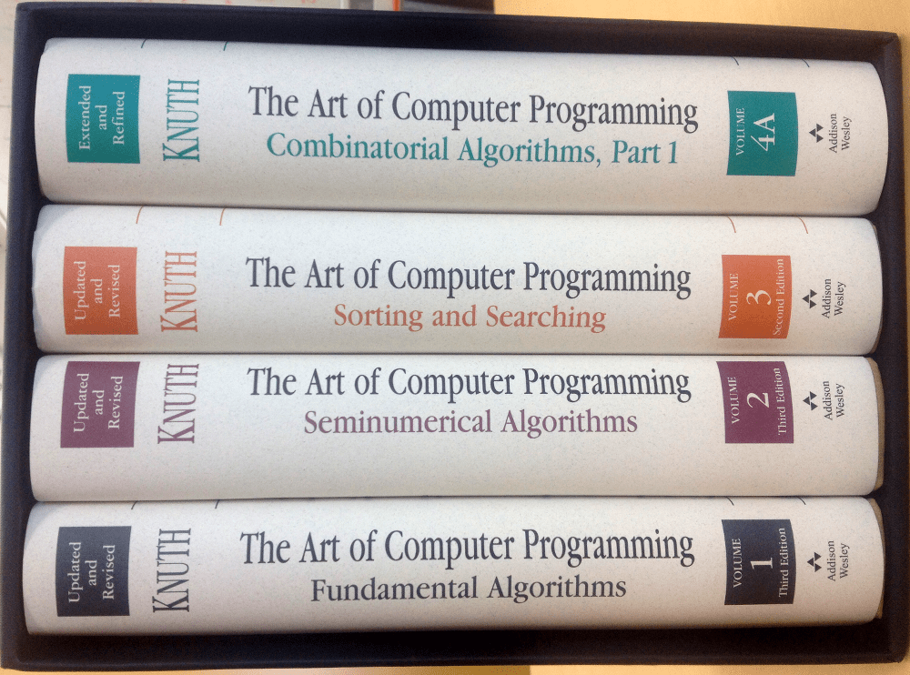
3. Resources:
- Popular books
- Introduction to Algorithms, Cormen
- Algorithms & Data Structure, Wirth
- The Art of Computer Programming, Knuth
- Animations
Advanced Sorting Algorithm Visualizer
Visualgo Sorting Animation
- Online courses e.g. MIT:
Introduction to computational thinking
Introduction to algorithms
Design and analysis of algorithms
Introduction to the Theory of Computation
Dr. Ibraheem Al-Dhamari ia@idhamari.com

Slide 23
Thank You
Dr. Ibraheem Al-Dhamari ia@idhamari.com

